Slide 1
OOP PROJECT
TEAM 7
ESCIGMA

Slide 2
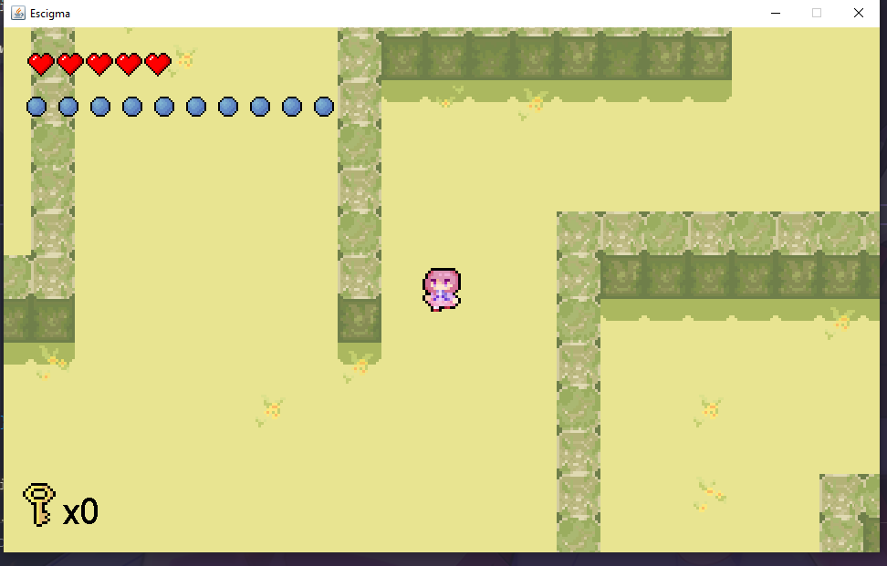
1.INTRODUCTION
This project will use object-oriented programming as the foundation to create a game.
Two dimensional maze game.
The game begins at the entrance of the labyrinth.
Players are armed with a basic map, and a weapon to discover the maze.
The labyrinth is a multi-level structure, with each level presenting a unique challenge.

Slide 3
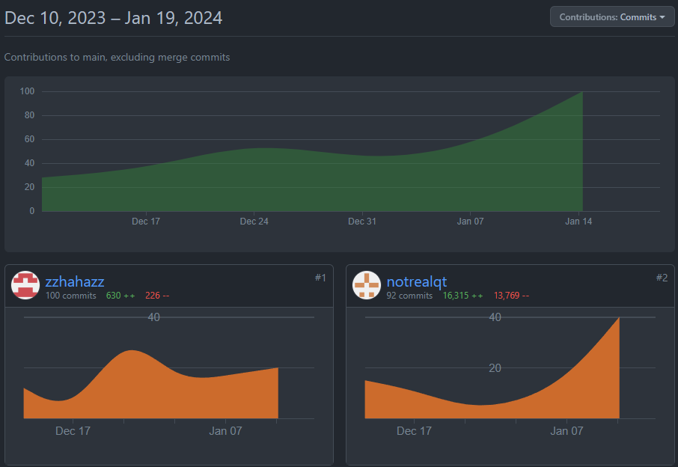
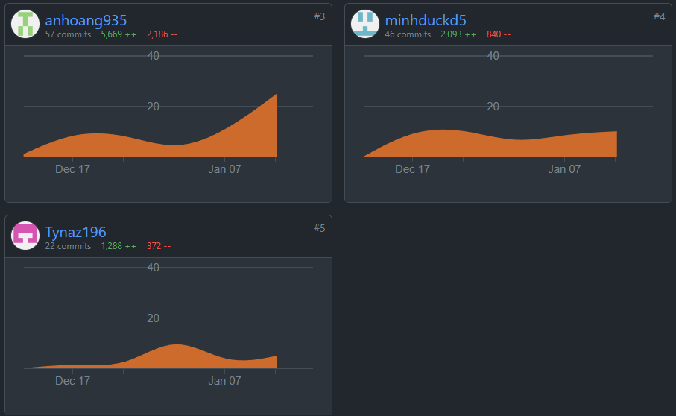
2.CONTRIBUTION
Thái Quang Tính - notrealqt - 20%
Nguyễn Trọng Thuận - Tynaz196 - 20%
Nguyễn Huỳnh Minh Đức - minhduckd5 - 20%
Hoàng Thiên Ân - anhoang935 - 20%
Nguyễn Phát Lợi - zzhahazz - 20%

Slide 4
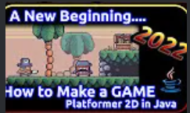
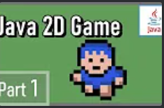

3.REFERENCE

Slide 5

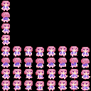

CHARACTER DESIGN

Slide 6
CHARACTER DESIGN

Slide 7




MONSTER DESIGN
Mushroom
Mimic
Floating Eyes
Slime

Slide 8
MONSTER DESIGN
Mushroom
Mimic
Floating Eyes
Slime

Slide 9


BOSS

Slide 10


ITEMS

Slide 11
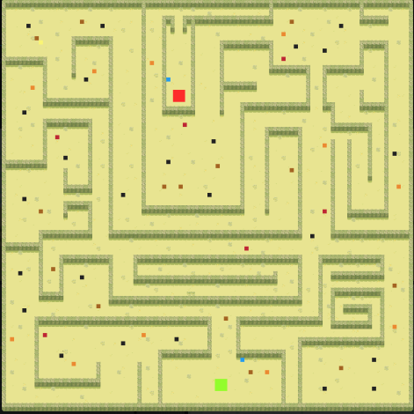
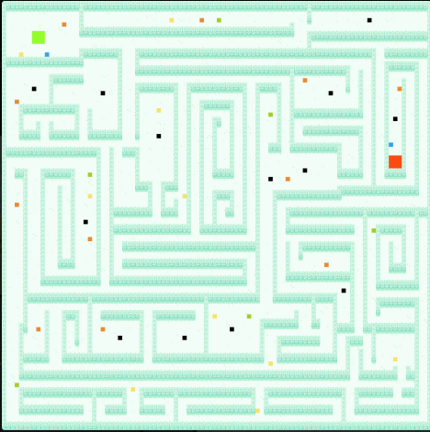
MAP
Map 1
Map 2

Slide 12
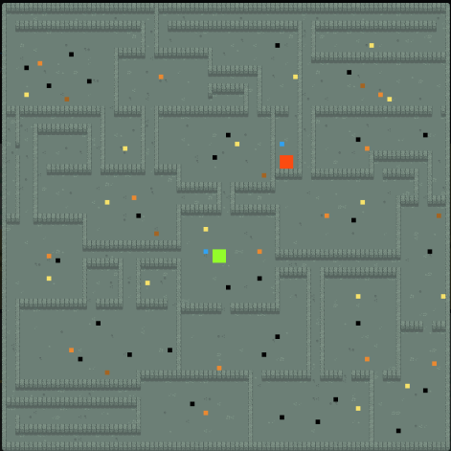
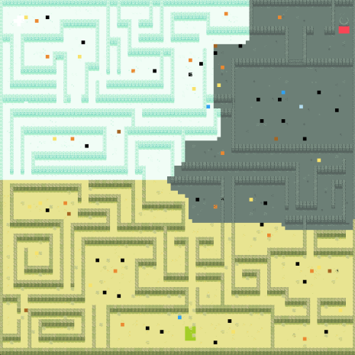
MAP
Map 3
Final Map

Slide 13
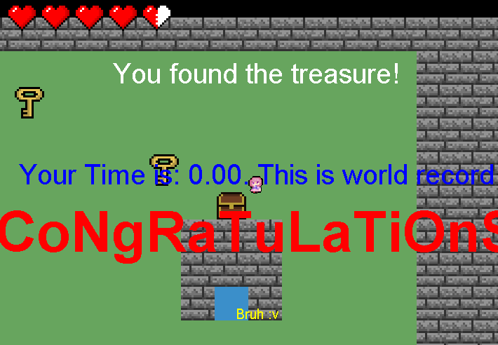
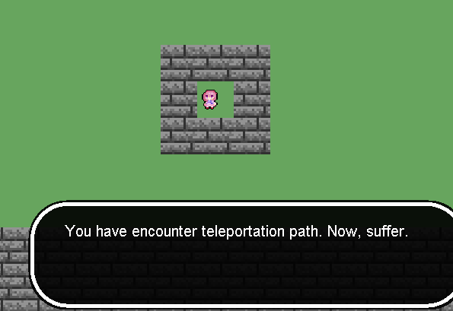
Early Level Design

Slide 14
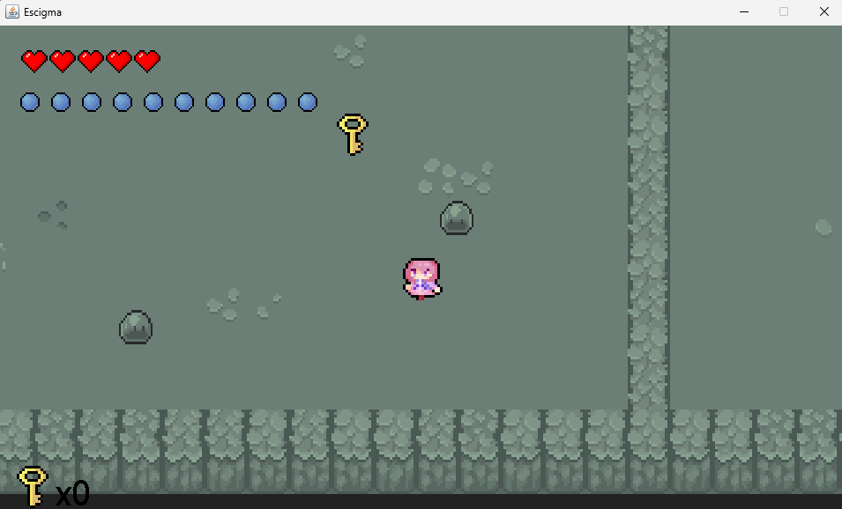
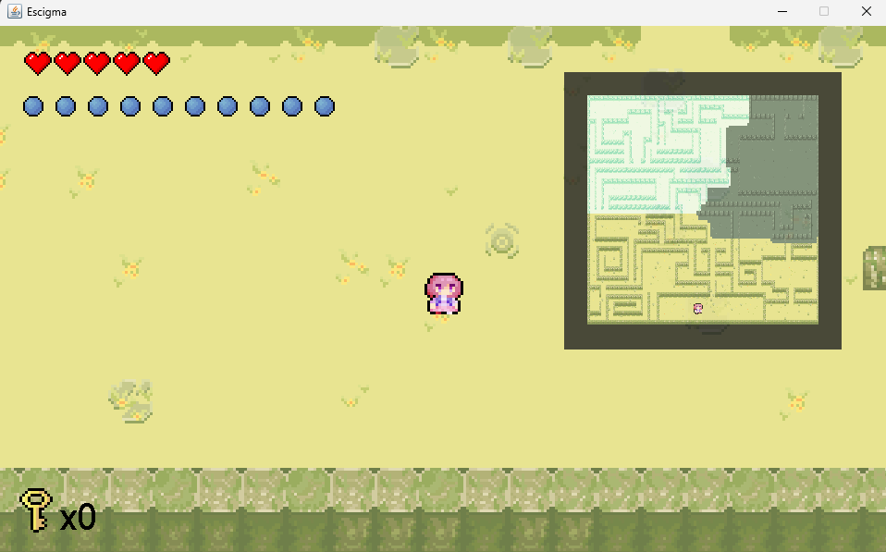
Final Level Design

Slide 15
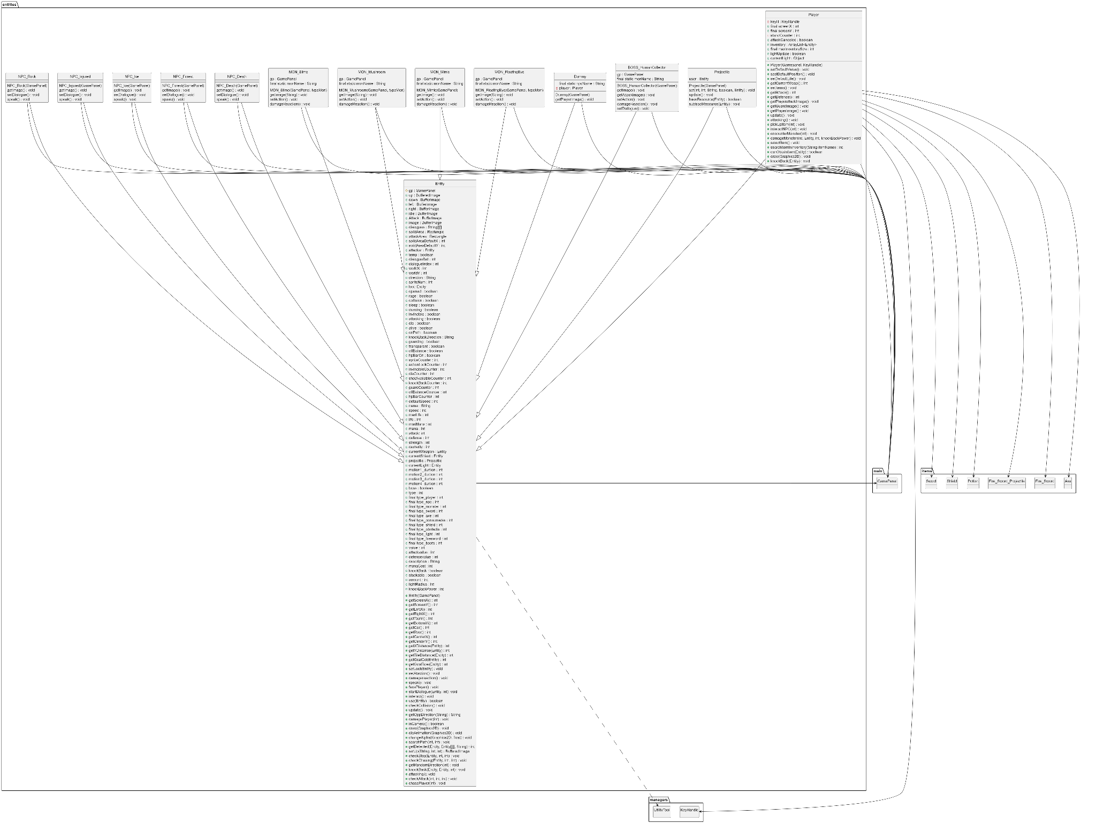
4.UML
Package
entitites
https://raw.githubusercontent.com/notrealqt/oop-project-IU/main/Report/UML/entities/entities.png

Slide 16
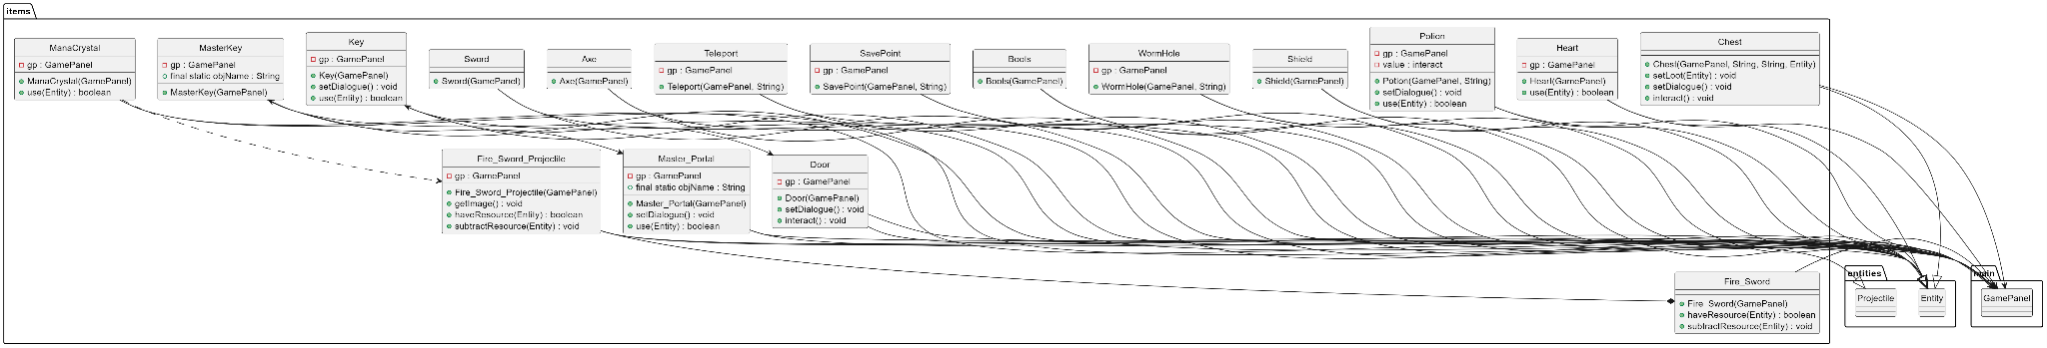
4.UML
https://raw.githubusercontent.com/notrealqt/oop-project-IU/main/Report/UML/items/items.png
Package items

Slide 17
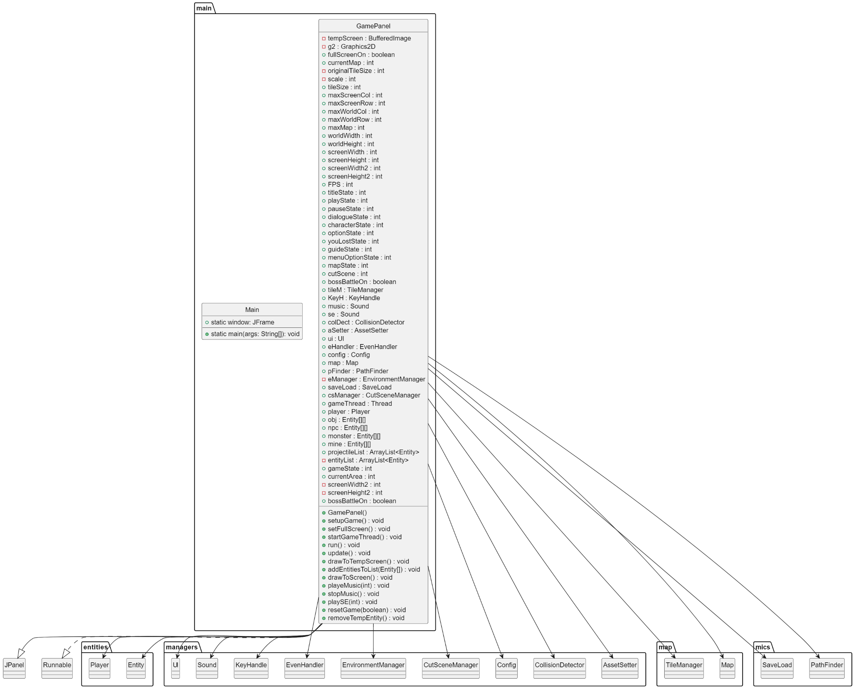
4.UML
Package
main
https://raw.githubusercontent.com/notrealqt/oop-project-IU/main/Report/UML/main/main.png

Slide 18
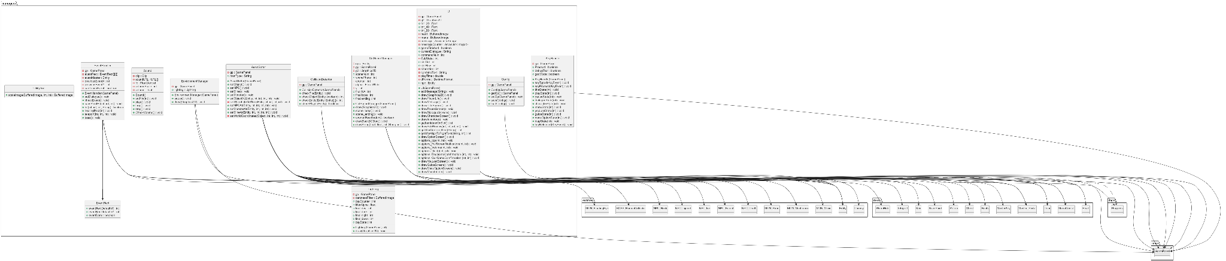
4.UML
https://raw.githubusercontent.com/notrealqt/oop-project-IU/main/Report/UML/managers/managers.png
Package managers

Slide 19
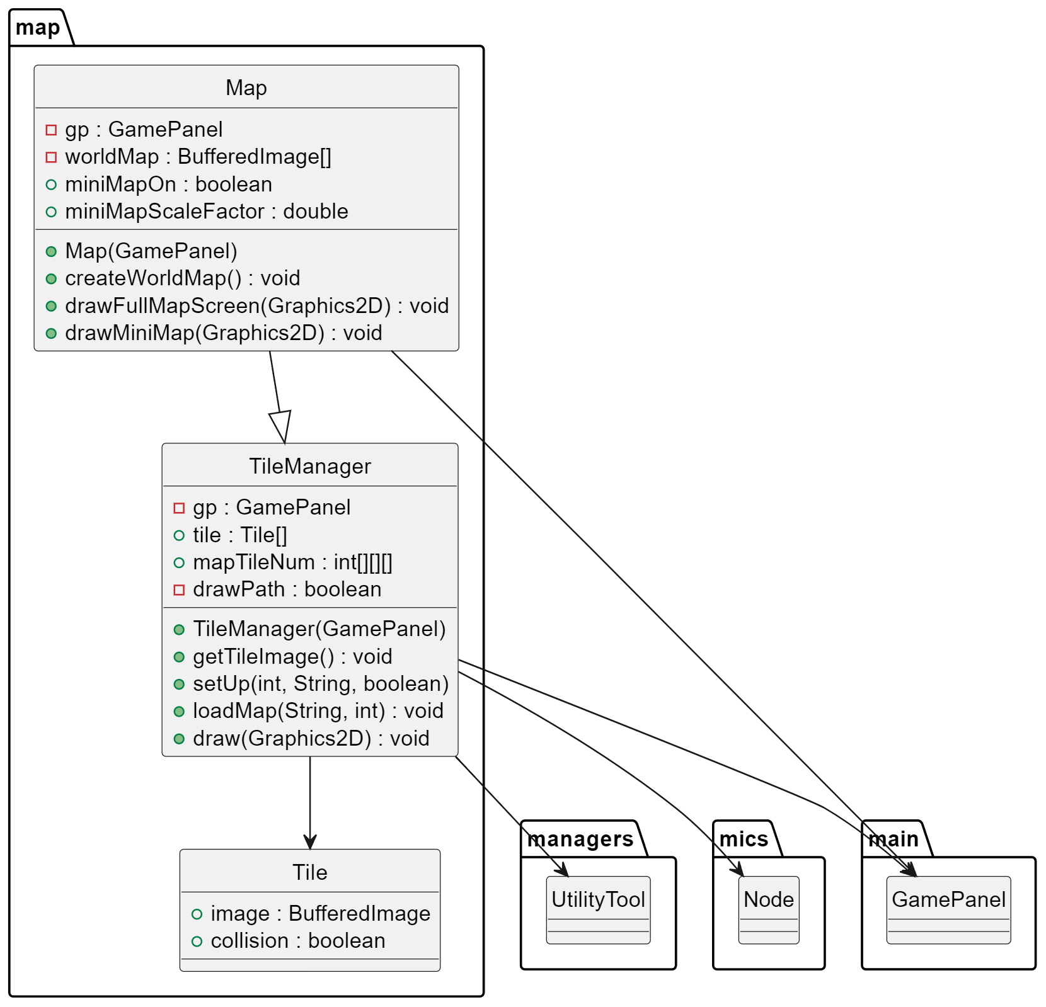
4.UML
Package
map
https://raw.githubusercontent.com/notrealqt/oop-project-IU/main/Report/UML/map/map.png

Slide 20
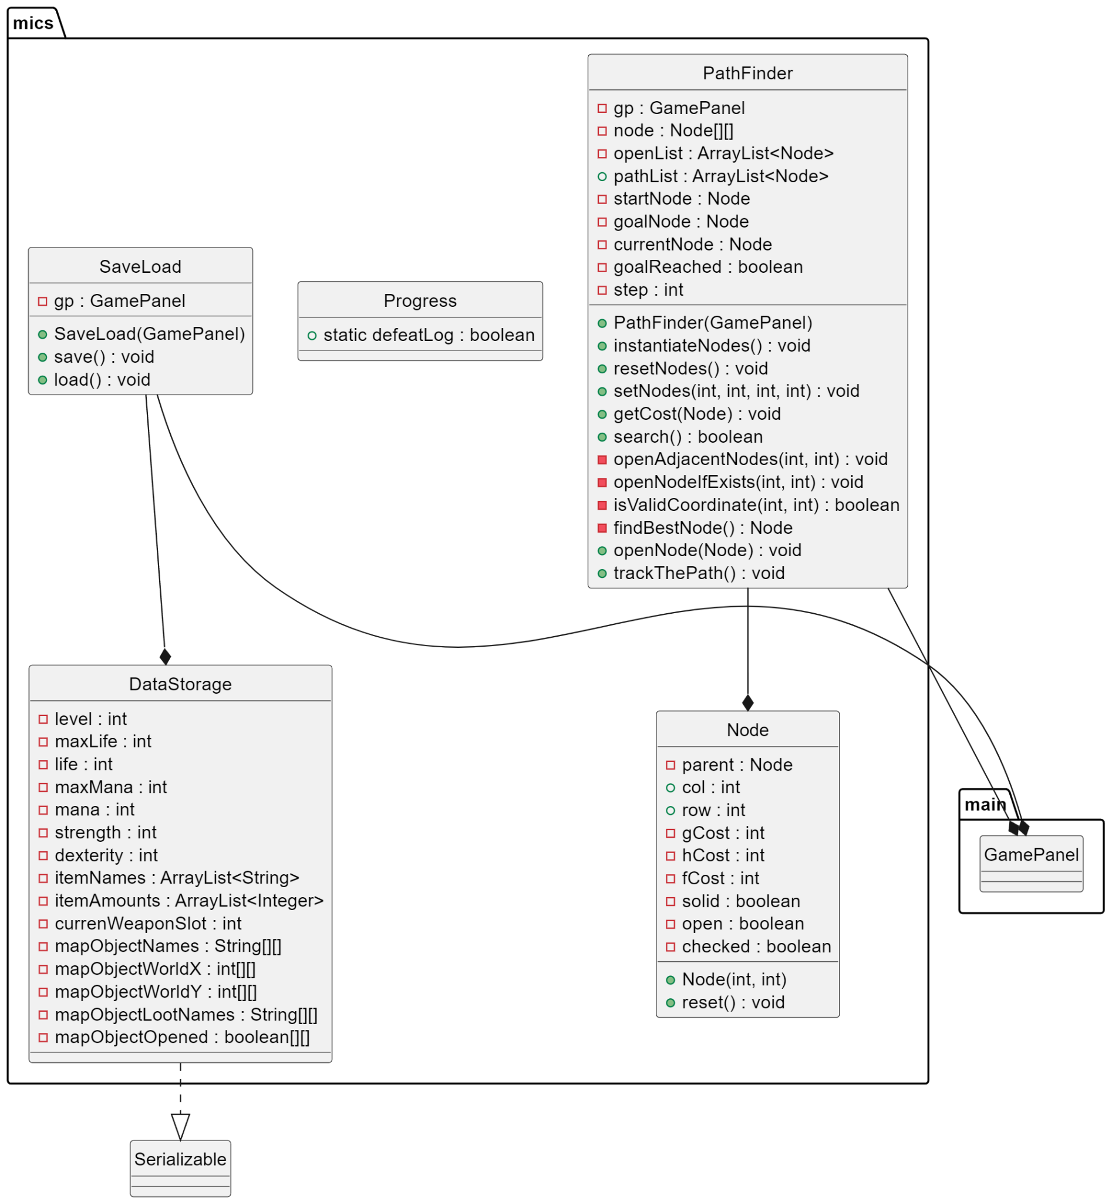
4.UML
Package
mics
https://raw.githubusercontent.com/notrealqt/oop-project-IU/main/Report/UML/mics/mics.png

Slide 21
5.GAME DEMO

